Slide 1
CTPY PROJECT “Food Waste Management System”
By-
Dishant , GAURAV , FAHAD AND HIMANSHU
SECTION :- “B”
SEM :-”3RD ”

Slide 2
INTRODUCTION
It is a Food Waste Management System which helps restaurants to donate leftover foods to the ones in need. About 811 million, that’s an astounding 9% of the world population is affected with this. These numbers will just rise due to the pandemic. This system aims at reducing this number and feeding the hungry.

Slide 3
OVERVIEW
There are 3 ways a user can help :
1. Restaurant owners –
owners can donate their leftover food to the nearest assumed camps in the particular city. Only thing they will be asked to do is fill out a form related to the location, amount of food supply, how many people it can feed, type of food etc..

Slide 4
OVERVIEW
We assume that we have set up the camps in certain localaties of the following areas of our city–
- HSR layout
- Electronic city
- Rajaji nagar
- Indira nagar
- Brigade road
- Koramangala
Etc…

Slide 5
OVERVIEW
So you can now send the foods to the nearest camp from your restaurant location. We are using API keys(google maps) for it to operate effectively. It wiil display the route the nearest camp with real time data.

Slide 6
2nd way
You can also donate food from your house through the same procedure, you just have to select your residential area and it will guide you to the nearest camp assumed.

Slide 7
3rd way
You can also sign up to volunteer for the work such as distributing food at camps, running errands, transferring food etc.. You can choose when to volunteer as per your convenience.

Slide 8
Data Flow
On starting the process, it will ask you to select from the 3.
1. Restaurant owner
2. Volunteer
3. Donating food from home
Then it will explain the user about roles and ask them to provide releted information regarding that particular option you chose.

Slide 9
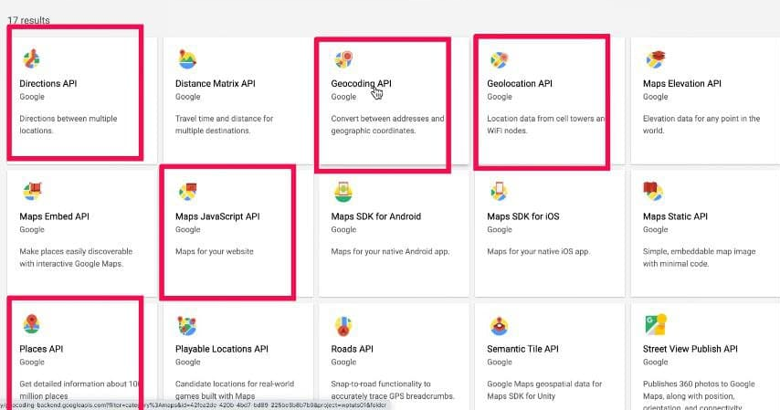
Software requirements (API KEYS)

Slide 10
Software requirements
PIP
GOOGLE MAPS API
REQUEST MODULE

Slide 11
THANK YOU

